Slide 1

BREAKING NEWS
Fueling Costs in a Volatile World: How Exchange Rates Impact Gas Prices in Canada
A Data-Driven Exploration using SQL, PostgreSQL & Canadian Open Data

Slide 2

Herizo R. (Jay) a trilingual Business & Data Analyst who’s obsessed with turning messy data into clean insights — and clean insights into smart decisions.
With hands-on experience across finance, tech, and retail, I’ve helped companies make faster, data-backed choices by building predictive models, cleaning datasets, and designing dashboards that actually get used.
Linkedin: www.linkedin.com/in/herizo-jose-andre
Why this project?
• Fuel is an everyday cost for Canadians, yet it’s impacted by complex global forces.
• Since oil is priced in USD, forex movements directly affect local fuel prices.
• I wanted to explore this connection using real-world data and uncover insights.
AUTHOR SPOTLIGHT
Business & Data Analyst Portfolio · 2025

Slide 3

Main Objectives:
• Understand if USD/CAD and CNY/CAD fluctuations influence gas prices in Canada.
• Discover which provinces are most impacted by forex volatility.
• Provide insights relevant to consumers, analysts, and logistics decision-makers.
Key Questions:
1. Which provinces pay the most for fuel?
2. Is a weaker Canadian dollar linked to higher gas prices?
3. Which provinces are most sensitive to exchange rate changes?
WASTE MANAGEMENT
HERIZO RAKOTONDRAMPANANA

Slide 4



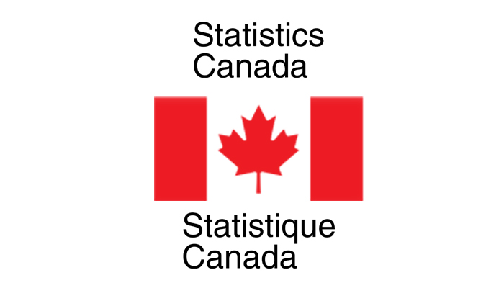
PostgreSQL
Excel
Bank of Canada (Data)
Statistics Canada (Data)
Database setup, Querying, Data wrangling, Joins, Views, Aggregations, Correlation analysis
Data wrangling and visualizations
Daily Foreign Exchange Rates (2017–2025)
Monthly Fuel Prices (Regular Unleaded, 2017–2025)
Tools & Data Sources
HERIZO RAKOTONDRAMPANANA

Slide 5
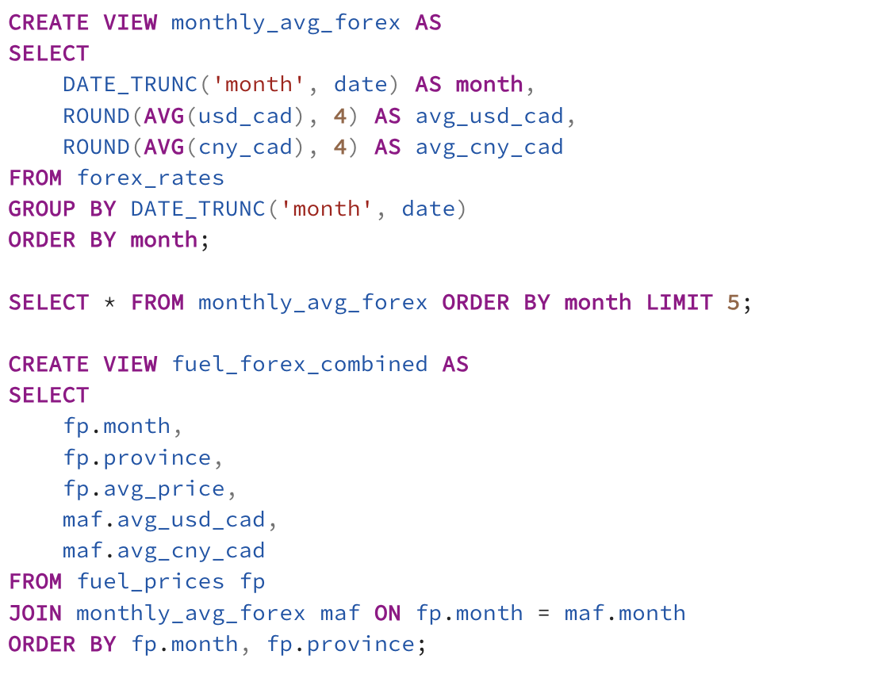
Tables Created:
1. forex_rates
• date, usd_cad, cny_cad
2. fuel_prices
• month, province, avg_price
Views Created:
• monthly_avg_forex – monthly average exchange rates
• fuel_forex_combined – joined view of fuel prices + exchange rates
Database Design & Structure
HERIZO RAKOTONDRAMPANANA

Slide 6
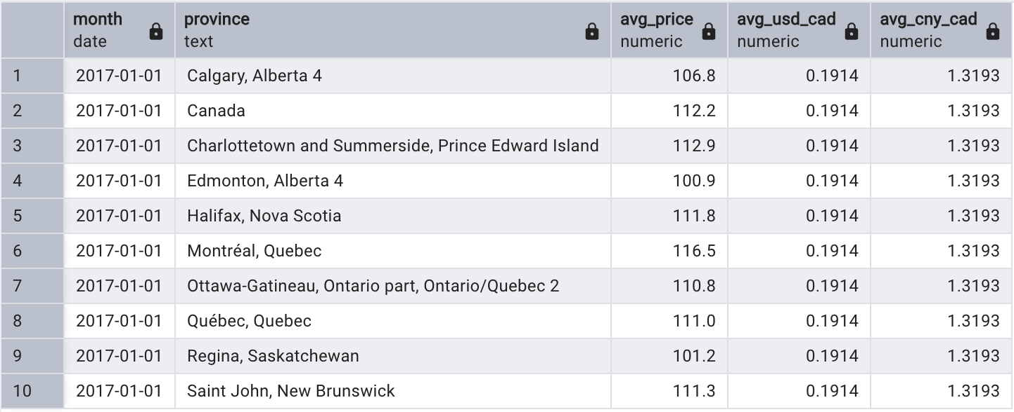
Sample Combined Dataset: fuel_forex_combined
• month, province, avg_price, avg_usd_cad, avg_cny_cad
We created a monthly view of gasoline prices across provinces, combined with exchange rate averages.
Data Preview (Joined View)
HERIZO RAKOTONDRAMPANANA

Slide 7
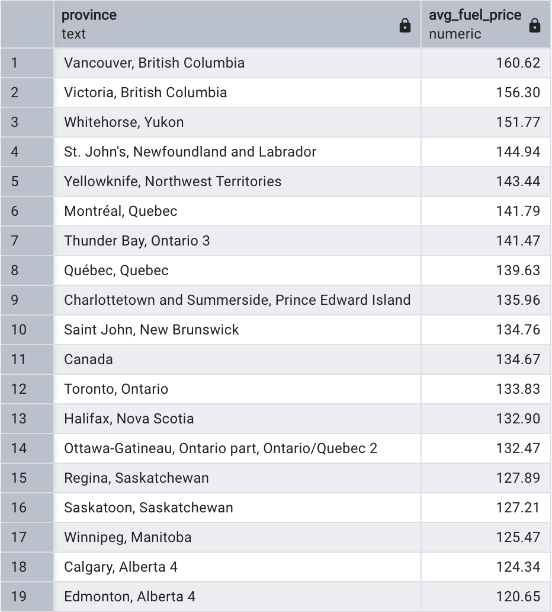
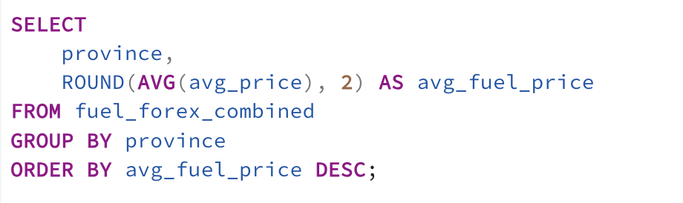
Insight:
• Provinces like British Columbia and Newfoundland rank highest in fuel cost.
• This reflects geographic, taxation, and logistical factors.
Insight 1 – Fuel Cost by Province
HERIZO RAKOTONDRAMPANANA

Slide 8
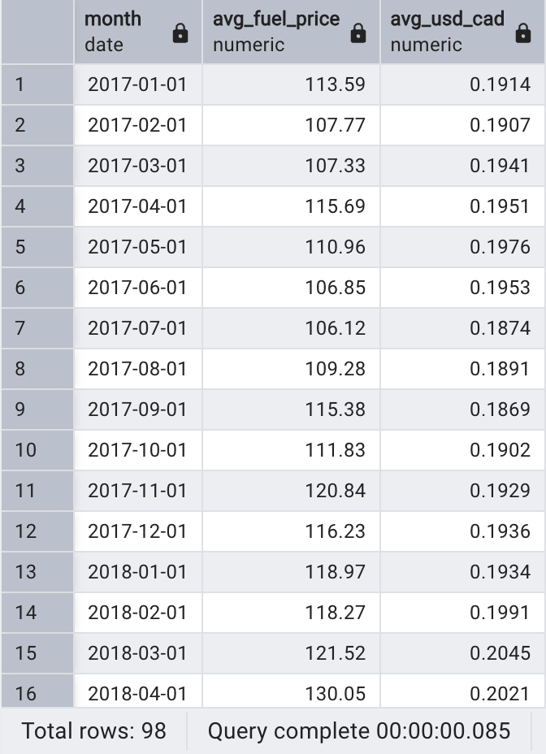
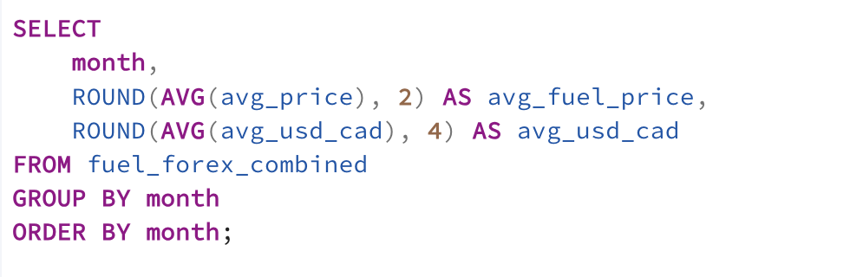
Insight:
• Higher USD/CAD (weaker CAD) aligns with rising fuel prices.
• Oil priced in USD becomes more expensive in CAD terms.
• This correlation supports budgeting and forecasting.
Insight 2 – CAD vs Fuel Price Trend
HERIZO RAKOTONDRAMPANANA

Slide 9
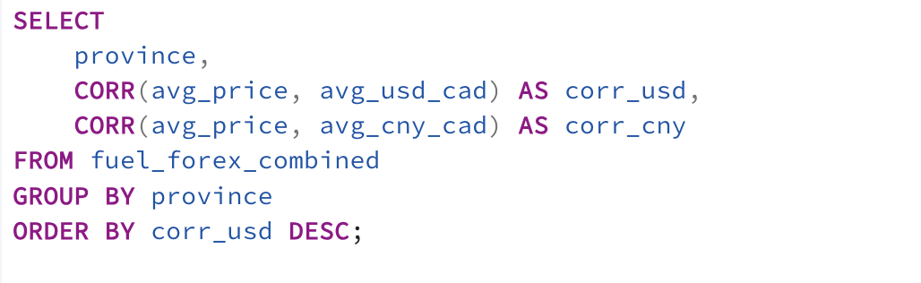
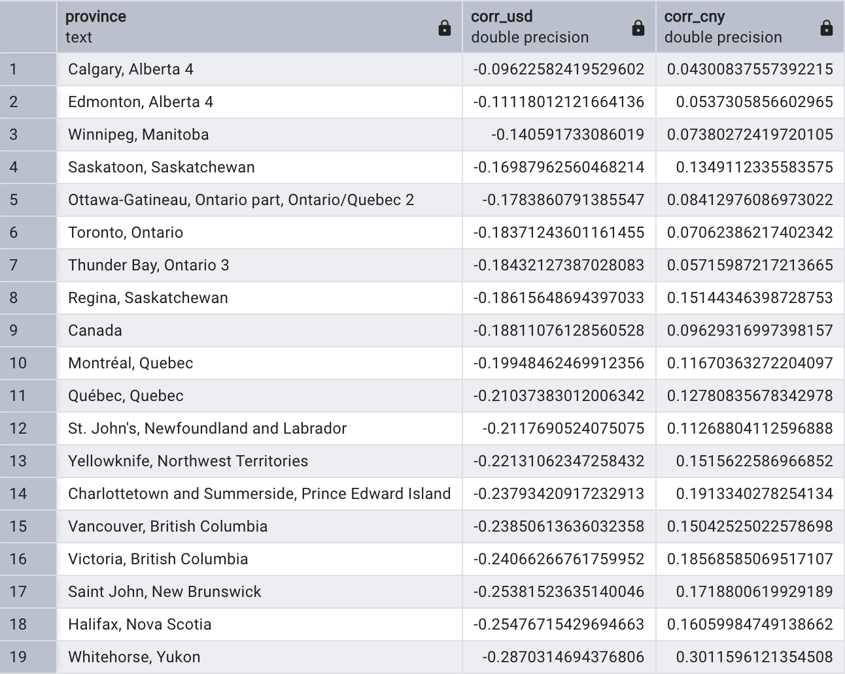
Insight:
• Provinces like Ontario and BC show high correlation to USD/CAD fluctuations.
• Regional planners and fuel budgeters can benefit from this knowledge.
Insight 3 – Province Sensitivity to FX Volatility
HERIZO RAKOTONDRAMPANANA

Slide 10
Key Takeaways:
• Real-world fuel prices in Canada are influenced by forex movements, especially USD/CAD.
• Regional differences in fuel pricing are consistent and measurable.
• SQL was used to model, clean, and analyze data with business insight.
What we learned:
• Deepened skills in SQL (joins, views, aggregation, correlation)
• Connected finance and data in a practical, bilingual Canadian context
• Delivered insights that could drive action in policy, logistics, or budgeting
Conclusion & Takeaways
HERIZO RAKOTONDRAMPANANA

Slide 11
“
Data is the new oil — and insights are the fuel that drive change.
— Thank you for watching
The project materials are available at: https://proherizoja.wixsite.com/herizojoseandre

